Slide 1
Week 7
NX9523: Business Professional Practice
Notes:
1

Slide 2
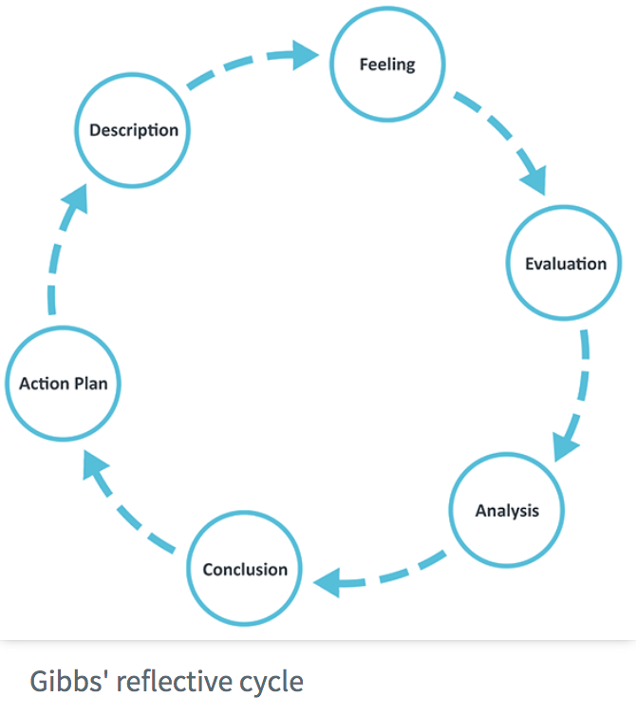
Reflective Writing
Reminder:
Reflection is a key part of learning
Reflection and writing reflectively are key skills to develop for the individual assessment
Develop your skills by:
Using a reflective model to structure your reflection (e.g. Gibbs Reflective Cycle)
Reflecting on the feedback received for your reflective pieces on NX9410 BBP (if you took this module)
Engaging with the Reflective Writing materials on Blackboard, including examples
Practicing and refining your reflective writing
Keeping notes of key incidents on your project to reflect on
Considering how your experiences will impact on your future studies and career e.g. skills developed
Notes:
2

Slide 3

Activity
Spend 15 minutes individually reading “The Park”, available from the Assessment folder on the NX9523 Blackboard site, on the “Reflective Writing – different approaches and frameworks” page.
‘The Park’ is four pieces of reflective writing about the same incident
As you read make notes about strengths and weaknesses of each piece. Which piece do you think is the best and why?
Notes:
3

Slide 4

Park 1
Tells a story
Ideas of others mentioned but not elaborated or given meaning
Only one point of view
Not all ideas presented are relevant
Emotions not explored
Verdict: Hardly reflective at all
Notes:
4

Slide 5
Park 2
Largely a story
Questions motives for behaviour but not explored in detail
Little analysis of events (questions not answered)
Some ‘standing back’ of the narrator as critiques events
No addition of ideas from outside the event
Verdict: Some reflection but not deep
Notes:
5

Slide 6
Park 3
Description is sufficiently succinct (Not a story)
Analysis of the situation
Considers other alternatives
Doesn’t acknowledge other points of view
More of a sense of ‘standing back’ to reflect on and critique actions
Doesn’t recognise influence of frame of reference/previous experience
Verdict: Good attempt at reflection but could be improved
Notes:
6

Slide 7
Park 4
Succinct and to the point
Questions beliefs and values underpinning behaviour
Evidence of ‘standing back’, views self as an object
Internal dialogue of alternatives
Deep reflection that is self-critical
Recognises significance of passing of time
Verdict: Deep reflection, the best of the 4
Recognises what can be learnt from the situation
Notices the effect of others on behaviour/reflection
Reflects on own reflection
Notes:
7

Slide 8

In deepening reflection there are shifts:
from description to a reflective account
From no questions, to questions, to responding to questions
Emotional influence is recognized, and then handled increasingly effectively
There is a ‘standing back from the event’
There is a shift from self questioning to challenging to own ideas
Recognition of relevance of prior experience
In the taking into account of others’ views
Towards being reflexive – reviewing own reflective processes.
More resources in the Assessment folder!
Notes:
8

